Slide 1

PROJECT TITLE:RAINFALL PREDICTION USING MACHINE LEARNING
Design Supervisor Name: DR.MINU SUSAN JACOB
Name of the Student : INDUKURI H P RAKESH VARMA
Register Number : 41611066

Slide 2
Presentation Outline
Abstract
Introduction
Existing Availabilities
Disadvantage of existing Product
Proposed Product
Advantage of proposed Product
Design requirements
Design Diagram
Product Working Principle
Product Photograph view(3D)
Reference

Slide 3
Abstract
India is an agricultural country and its economy is largely based upon crop productivity and rainfall. For analyzing the crop productivity, rainfall prediction is require and necessary to all farmers. Rainfall Prediction is the application of science and technology to predict the state of the atmosphere. It is important to exactly determine the rainfall for effective use of water resources, crop productivity and pre planning of water structures. Using different data mining techniques it can predict rainfall. Data mining techniques are used to estimate the rainfall numerically. This paper focuses some of the popular data mining algorithms for rainfall prediction. Naive Bayes, K-Nearest Neighbour algorithm, Decision Tree, Neural Network and fuzzy logic are some of the algorithms compared in this paper. From that comparison, it can analyze which method gives better accuracy for rainfall prediction.

Slide 4
Introduction
Rainfall Prediction is one of the most challenging tasks. Though already many algorithms have being proposed but still accurate prediction of rainfall is very difficult. In an agricultural country like India, the success or failure of the crops and water scarcity in any year is always viewed with greatest concern. A small fluctuation in the seasonal rainfall can have devastating impacts on agriculture sector. Accurate rainfall prediction has a potential benefit of preventing causalities and damages caused by natural disasters. Under certain circumstances such as flood and drought, highly accurate rainfall prediction is useful for agriculture management and disaster prevention. In this paper, various algorithms have been analyzed. Data mining techniques are efficiently used in rainfall prediction.

Slide 5
EXISTING AVAILABILITIES
Agriculture is the strength of our Indian economy. Farmer only depends upon monsoon to be their cultivation. The good crop productivity needs good soil, fertilizer and also good climate. Weather forecasting is the very important requirement of the each farmer. Due to the sudden changes in climate/weather, The people are suffered economically and physically. Weather prediction is one of the challenging problems in current state. The main motivation of this paper to predict the weather using various data mining techniques. Such as classification, clustering, decision tree and also neural networks. Weather related information is also called the meteorological data.

Slide 6
Disadvantages of the existing Product
Classification
Clustering
Decision Tree

Slide 7
Proposed Product
Rainfall is important for food production plan, water resource management and all activity plans in the nature. The occurrence of prolonged dry period or heavy rain at the critical stages of the crop growth and development may lead to significant reduce crop yield. India is an agricultural country and its economy is largely based upon crop productivity. Thus rainfall prediction becomes a significant factor in agricultural countries like India. Rainfall forecasting has been one of the most scientifically and technologically challenging problems around the world in the last century.

Slide 8
Advantages of the proposed product
Numerical Weather Pediction
Statistical Weather Prediction
Synoptic Weather Prediction

Slide 9
Design Requirements
HARDWARE REQUIREMENTS:
System - Windows7/10
Speed - 2.4GHZ
Hard disk - 40GB
Monitor - 15VGA
Color Ram - 4GB
SOFTWARE REQUIREMENTS(if needed):
Coding Language - PYTHON
IDE - PYCHARM

Slide 10
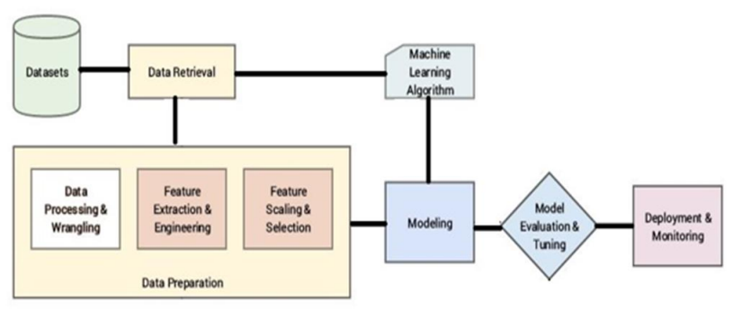
ARCHITECTURE

Slide 11
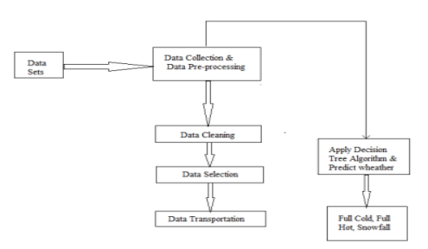
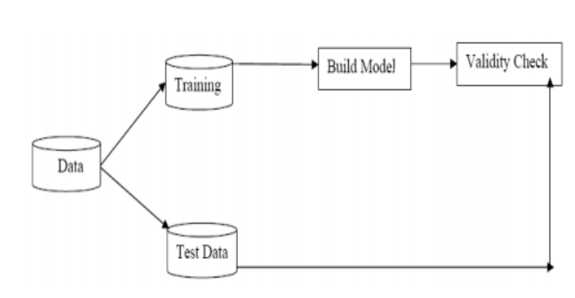
DATAFLOW DIAGRAM
LEVEL 0: LEVEL 1:

Slide 12
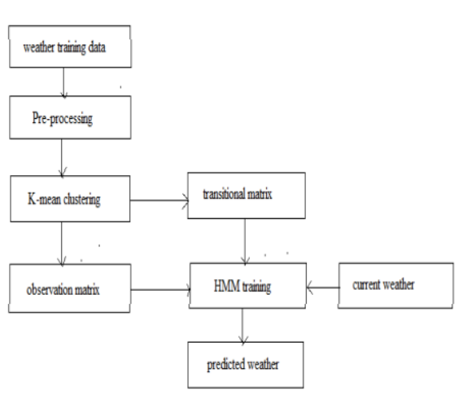
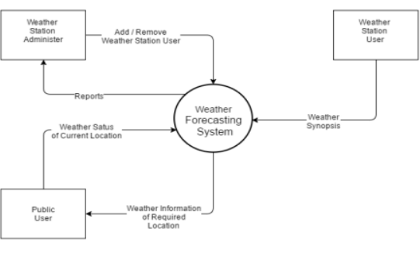
DATAFLOW DIAGRAM
LEVEL 2: LEVEL 3:

Slide 13
Reference
Pritpal Singh et al. [1] developed a new method to predict Indian Summer Monsoon Rainfall (ISMR), as traditional methods are not very accurate. Their approach combines object creation, entropy, and artificial neural networks (ANN). The model was validated using studio experiments and research data, showing superior performance compared to traditional techniques.
Sam Carmer et al. [2] emphasized the superiority of AI algorithms over traditional methods for rainfall prediction. They compared six leading AI models to the existing Markov chain-based approach, using data from 42 urban cities for a comprehensive evaluation.
Sahar Hadi Poura et al. [3] employed Random Forest (RF) for non-rainy days and Support Vector Machine (SVM) for rainy days in predicting rainfall. Their hybrid model improved accuracy and replicated various rainfall patterns, including consecutive rainy days, monthly rainfall, and rainfall distribution in eastern Malaysia.
N. Divya Prabha et al. [5] addressed the difficulty of creating long-term water overviews without rainfall data. They proposed using complex neural networks for seasonal rainfall prediction and verified their approach with a complex perceptron neural network. Their evaluation included metrics like MSE and NMSE, particularly focusing on short-term planning datasets and models like Adanaive and AdaSVM.
Yashas Athreya et al. [7] developed a Machine Learning program for rainfall analysis, specifically to predict and mitigate the impacts of floods. This program is accessible to both the general public and government agencies, offering early warnings and support measures to prepare for and respond to floods.

Slide 14

THANK YOU

